Slide 1
Generalized Streaming Data Architecture
Pravin Y Pawar

Slide 2
Streaming Data Systems
Defined again
… are layered systems that rely on several loosely coupled systems
Helps in achieving high availability
Helps in managing the system
Helps in maintaining the cost under control
All subsystems / components can reside on individual physical servers or can be co hosted on the single or more than one servers
Not all components to be present in every system
Contents adapted from Real-Time Analytics , Byron Ellis

Slide 3
Streaming Data System Components
Streaming Data System Architecture Components
Collection
Data Flow
Processing
Storage
Delivery

Slide 4
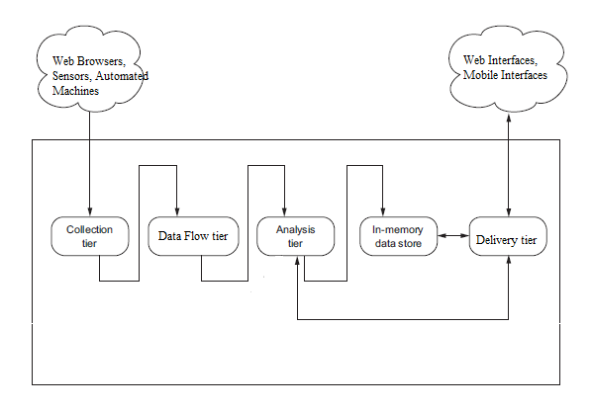
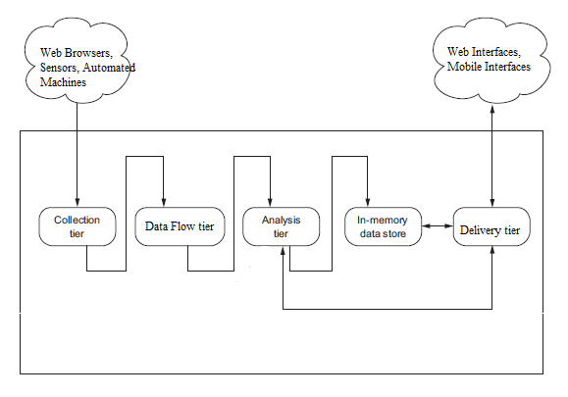
Generalized Architecture
Altered version, original concept : Andrew G. Psaltis

Slide 5
Architecture Components (1)
Collection System
Mostly communication over TCP/IP network using HTTP
Websites log data was the initial days use case
W3C standard log data format was used
Newer formats like JSON, AVRO, Thrift are available now
Collection happens at specialized servers called edge servers
Collection process is usually application specific
New servers integrates directly with data flow systems
Old servers may or may not integrate directly with data flow systems

Slide 6
Architecture Components (2)
Data Flow Tier
Separation between collection tier and processing layer is required
Rates at which these systems works are different
What if one of system is not able to cope with another system?
Required intermediate layer that takes responsibility of
accepting messages / events from collection layer
providing those messages / events to processing layer
Real time interface to data layer for both producers and consumers of data
Helps in guaranteeing the “at least once” semantics

Slide 7
Architecture Components (3)
Processing / Analytics Tier
Based on “data locality” principle
Move the software / code to a the location of data
Rely on distributed processing of data
Framework does the most of the heavy lifting of data partitioning, job scheduling, job managing
Available Frameworks
Apache Storm
Apache Spark (Streaming)
Apache Kafka Streaming etc

Slide 8
Architecture Components (4)
Storage Tier
In memory or permanent
Usually in memory as data is processed once
But can have use cases where events / outcomes needs to be persisted as well
NoSQL databases becoming popular choice for permanent storage
MongoDB
Cassandra
But usage varies as per the use case, still no database that fits all use cases

Slide 9
Architecture Components (5)
Delivery Layer
Usually web based interface
Now a days mobile interfaces are becoming quite popular
Dashboards are built with streaming visualizations that gets continuously updated as underlying events are processed
HTML + CSS + Java script + Websockets can be used to create interfaces and update them
HTML5 elements can be used to render interfaces
SVG, PDF formats used to render the outcomes
Monitoring / Alerting Use cases
Feeding data to downstream applications

Slide 10
Lambda Architecture
Pravin Y Pawar

Slide 11
Lambda Architecture
Defined
Proposed by Nathan Marz based on his experience working on distributed data processing systems at Backtype and Twitter
A generic, scalable and fault-tolerant data processing architecture
Lambda Architecture
aims to satisfy the needs for a robust system that is fault-tolerant, both against hardware failures and human mistakes
being able to serve a wide range of workloads and use cases
in which low-latency reads and updates are required.
The resulting system should be linearly scalable, and it should scale out rather than up.

Slide 12
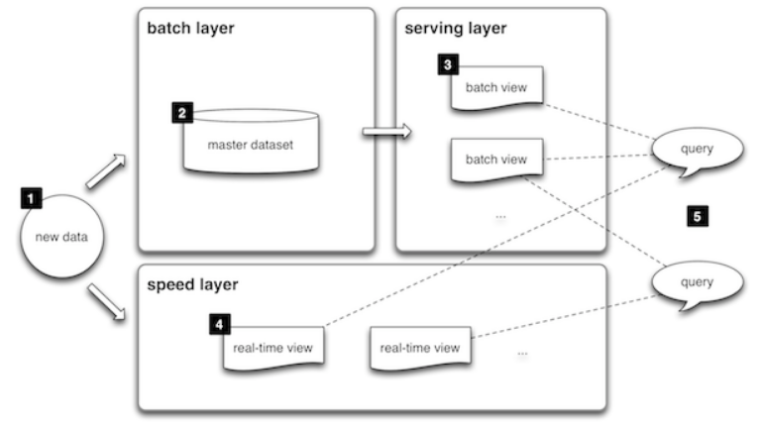
Lambda Architecture (2)
Block Diagram
Source : http://lambda-architecture.net/

Slide 13
Lambda Architecture (3)
Basic Flow of Events
All data entering the system is dispatched to both the batch layer and the speed layer for processing.
The batch layer has two functions:
managing the master dataset (an immutable, append-only set of raw data)
to pre-compute the batch views.
The serving layer indexes the batch views so that they can be queried in low-latency, ad-hoc way.
The speed layer compensates for the high latency of updates to the serving layer and deals with recent data only.
Any incoming query can be answered by merging results from batch views and real-time views.

Slide 14
Architectural Components (1)
Batch layer
New data comes continuously, as a feed to the data system.
It gets fed to the batch layer and the speed layer simultaneously.
It looks at all the data at once and eventually corrects the data in the stream layer.
Here we can find lots of ETL and a traditional data warehouse.
This layer is built using a predefined schedule, usually once or twice a day.
The batch layer has two very important functions:
To manage the master dataset
To pre-compute the batch views.
Source : https://databricks.com/glossary/lambda-architecture

Slide 15
Architectural Components (2)
Speed Layer (Stream Layer)
This layer handles the data that are not already delivered in the batch view due to the latency of the batch layer.
In addition, it only deals with recent data in order to provide a complete view of the data to the user by creating real-time views.
Speed layer provides the outputs on the basis enrichment process and supports the serving layer to reduce the latency in responding the queries.
As obvious from its name the speed layer has low latency because it deals with the real time data only and has less computational load.

Slide 16
Architectural Components (3)
Serving Layer
The outputs from batch layer in the form of batch views and from speed layer in the form of near-real time views are forwarded to the serving layer.
This layer indexes the batch views so that they can be queried in low-latency on an ad-hoc basis.

Slide 17
Applications of Lambda Architecture
User queries are required to be served on ad-hoc basis using the immutable data storage.
Quick responses are required and system should be capable of handling various updates in the form of new data streams.
None of the stored records shall be erased and it should allow addition of updates and new data to the database.

Slide 18
Pros and Cons of Lambda Architecture
Pros
Batch layer of Lambda architecture manages historical data with the fault tolerant distributed storage which ensures low possibility of errors even if the system crashes.
It is a good balance of speed and reliability.
Fault tolerant and scalable architecture for data processing.
Cons
It can result in coding overhead due to involvement of comprehensive processing.
Re-processes every batch cycle which is not beneficial in certain scenarios.
A data modelled with Lambda architecture is difficult to migrate or reorganize.
Source : https://towardsdatascience.com/a-brief-introduction-to-two-data-processing-architectures-lambda-and-kappa-for-big-data

Slide 19
Kappa Architecture
Pravin Y Pawar

Slide 20
Bad thing about Lambda Architecture
The problem with the Lambda Architecture is that maintaining code that needs to produce the same result in two complex distributed systems is exactly as painful as it seems like it would be.
Programming in distributed frameworks like Storm and Hadoop is complex. Inevitably, code ends up being specifically engineered toward the framework it runs on. The resulting operational complexity of systems implementing the Lambda Architecture is the one thing that seems to be universally agreed on by everyone doing it.
Interesting read : https://www.oreilly.com/ideas/questioning-the-lambda-architecture

Slide 21
Kappa Architecture
Defined
First described by Jay Kreps at Linkedin.
It focuses on only processing data as a stream.
It is not a replacement for the Lambda Architecture, except for where your use case fits.
For this architecture, incoming data is streamed through a real-time layer and the results of which are placed in the serving layer for queries.

Slide 22
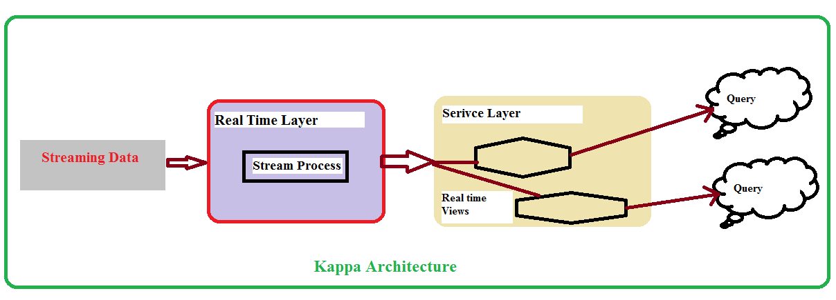
Kappa Architecture (2)
Block Diagram

Slide 23
Kappa Architecture (3)
The idea is to handle both real-time data processing and continuous reprocessing in a single stream processing engine.
This requires that the incoming data stream can be replayed (very quickly), either in its entirety or from a specific position.
If there are any code changes, then a second stream process would replay all previous data through the latest real-time engine and replace the data stored in the serving layer.
This architecture attempts to simplify by only keeping one code base rather than manage one for each batch and speed layers in the Lambda Architecture.
In addition, queries only need to look in a single serving location instead of going against batch and speed views.
Interesting read : https://www.talend.com/blog/2017/08/28/lambda-kappa-real-time-big-data-architectures/

Slide 24
Pros and Cons of Kappa architecture
Pros
Kappa architecture can be used to develop data systems that are online learners and therefore don’t need the batch layer.
Re-processing is required only when the code changes.
It can be deployed with fixed memory.
It can be used for horizontally scalable systems.
Fewer resources are required as the machine learning is being done on the real time basis.
Cons
Absence of batch layer might result in errors during data processing or while updating the database that requires having an exception manager to reprocess the data or reconciliation.
Interesting read : https://towardsdatascience.com/a-brief-introduction-to-two-data-processing-architectures-lambda-and-kappa-for-big-data-

Slide 25
Real Time System Characteristics
Pravin Y Pawar

Slide 26
BA ZC420, Real Time Analytics
Lecture No. 1.4

Slide 27
Agenda
Distinguishing Features of Streaming Data
Data always in motion
Data structuring
Data Cardinality
Features of Real-Time Architecture
High Availability
Low Latency
Horizontal Scalability

Slide 28
Distinguishing Features of Streaming Data
Data always in motion
Streaming data
getting generated continuously
Always flowing
Two critical requirements
Collection system should be robust
Processing should be able to keep pace with collection
Solutions
Horizontal Scalability
Algorithmic handling of streaming data

Slide 29
Distinguishing Features of Streaming Data - II
Data Structuring
Loosely structured
Various data sources
structured , unstructured data
Forming a joint schema is difficult
For example, social media streams
Young , evolving projects
Adds many dimensions to the data
Collect as much as data possible to make interesting analysis

Slide 30
Distinguishing Features of Streaming Data - III
Data Cardinality
Number of unique values in data
Very few values appears often, many are very sparce
Challenges with Streaming data
Processing
Streaming data can be processed only once
Difficult to identify state of data
Batch processing on processed data can be used for estimation
Storage
Memory requirements are high while processing data
Linear amount of space required for storing state information

Slide 31
Features of Real-Time Architecture
High Availability
Key distinguishing factor from batch / BI systems
Very critical for collection, flow and processing systems
Two Approaches
Distribution
Use multiple physical servers to distribute the load
Replication
Write to several machines
Master-slave configuration
Automatic failover
Master less configuration
Recovery is difficult in case of failure

Slide 32
Features of Real-Time Architecture - II
Low Latency
Time taken to service a request
Streaming systems latency
Time taken to process the event from the moment it entered the system
Many streaming systems works in batches
Micro batching – processing in very small batches, milli seconds
Collection systems bothers about first definition of latency
Flow and processing components bother about second one
Tradeoff between speed and safety
If data can be safely lost, latency can be very small
If not, needs to live with lower limit of latency

Slide 33
Features of Real-Time Architecture - III
Horizontal Scalability
Adding more physical servers to a clusters
Needs to care about amount of coordination required between the systems
Use of partitioning technique
Use principle of data locality – move program to data

Slide 34


Reference
Real-Time Analytics , Byron Ellis
Chapter 1 : Introduction to Streaming Data
Chapter 2 : Designing Real-Time Streaming Architecture

Slide 35
Thank You!
In our next session: Lambda Architecture

